Slide 1
Processes
Course Instructor: Safia Baloch

Slide 2
Objectives
Identify the separate components of a process and illustrate how they are represented and scheduled in an operating system.
Describe how processes are created and terminated: using the appropriate system calls that perform these operations.
Describe and contrast interprocess communication using shared memory and message passing.
Design programs that use pipes and POSIX shared memory to perform interprocess communication.
Describe client-server communication using sockets and remote procedure calls.
Design kernel modules that interact with the Linux operating system.(kernel level program a demo)

Slide 3
Process Concept
What is process ?
Q: Imagine that you have just turned on your computer and have not yet started any application. Are any programs running?
Yes--the operating system is running. Mostly it is managing the user interface, waiting for some input to tell it what to do.

Slide 4
Process Concept-1
Process is a program in execution
An operating system executes a variety of programs:
Batch system – jobs
Transactions are accumulated over time and processed identically.
example: a company may process the travel expenses of its employees on a monthly basis
Time-shared systems – user programs or tasks
Time-sharing is a technique which enables many people, located at various terminals, to use a particular computer system at the same time.
Time-sharing or multitasking is a logical extension of multiprogramming.
Notes:
batch processing: jobs with similar needs are batched together and run as a group(disadvantage :CPU is often idle, because the speed of the mechanical I/O devices is slower than the CPU)

Slide 5
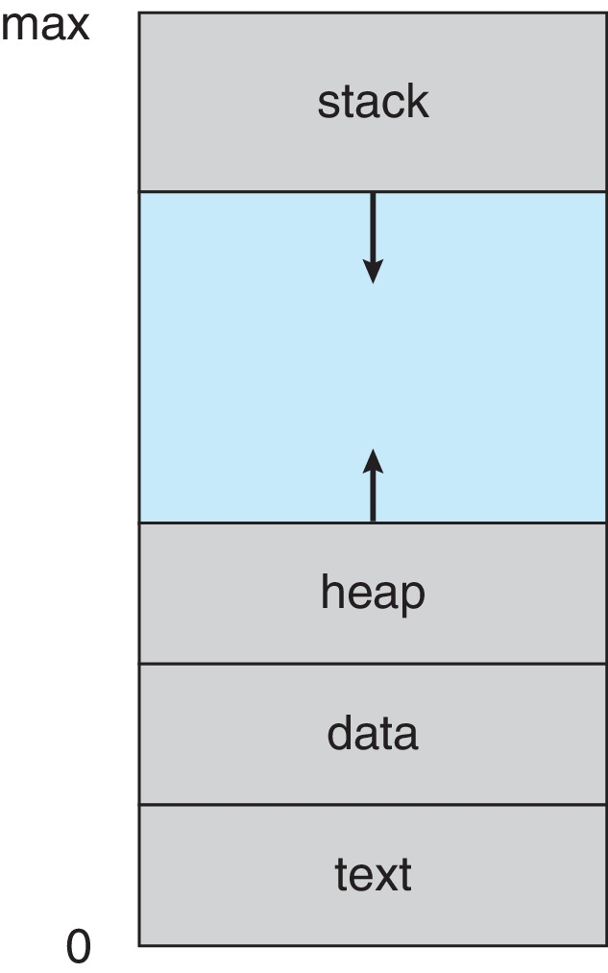
Process in memory
A Process is a Memory space and data structures

Slide 6
The Process Concept-2
Information required to maintain a process is called the Process Context.
Process context include Multiple parts such as
Program Counter
SPU register contents
Memory Layout of Process consisting on following parts:
Stack containing temporary data of Function parameters, return addresses, local variables
Heap containing memory dynamically allocated during run time
Data section containing global variables initialized and uninitialized
The program code, also called text section
Notes:
Example of passive and active?

Slide 7
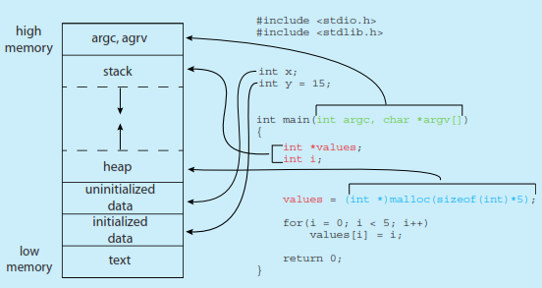
Layout of a Process in memory

Slide 8
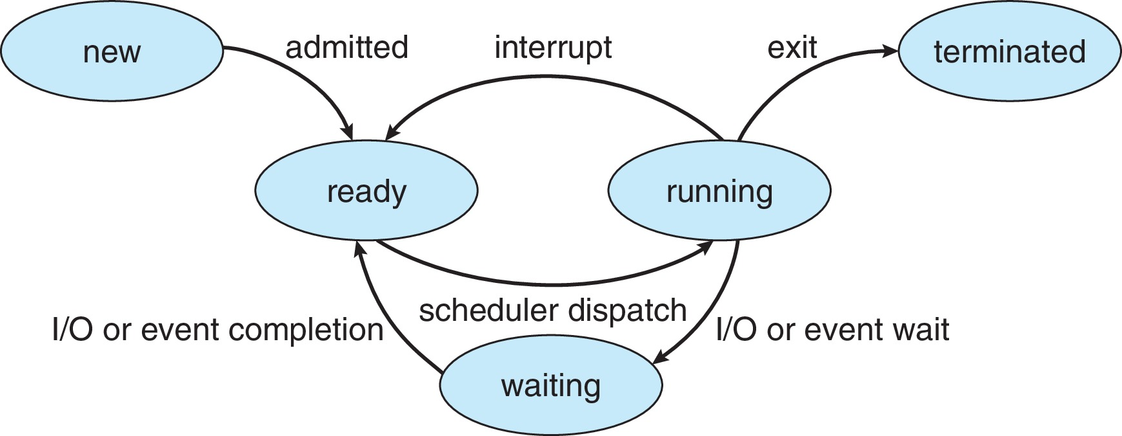
Diagram of Process State

Slide 9
Process State
As a process executes, it changes state
new: The process is being created
running: Instructions are being executed
waiting: The process is waiting for some event to occur
ready: The process is waiting to be assigned to a processor
terminated: The process has finished execution

Slide 10
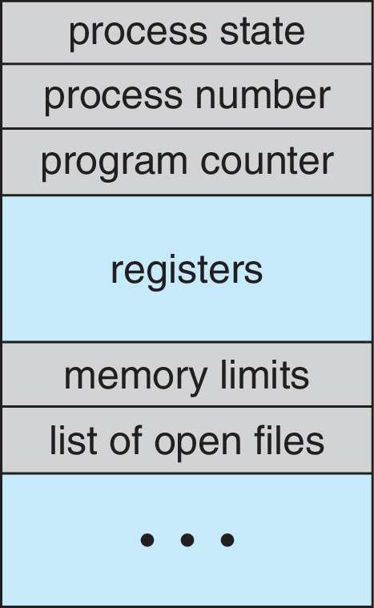
Process Control Block (PCB)-DS
Information associated with each process
(also called task control block)
Process state – running, waiting, etc
Program counter – location of instruction to next execute
CPU registers – contents of all process-centric registers
CPU scheduling information- priorities, scheduling queue pointers
Memory-management information – memory allocated to the process
Accounting information – CPU used, clock time elapsed since start, time limits, process number
I/O status information – I/O devices allocated to process, list of open files
Notes:
Along pc, cpu register state is also maintained.
In memory, base and the limit of registers and page tables segment tables are also maintained

Slide 11
Schedulers:
Long-term scheduler (or job scheduler) – selects which processes should be brought into the ready queue(memory)
Short-term scheduler (or CPU scheduler) – selects which process should be executed next and allocates CPU
Sometimes the only scheduler in a system

Slide 12
Process Scheduling
Maximize CPU use, quickly switch processes onto CPU for time sharing
Process scheduler selects among available processes for next execution on CPU
Maintains scheduling queues of processes:
Job queue – set of all processes in the system
Ready queue – set of all processes residing in main memory, ready and waiting to execute
Device queues – set of processes waiting for an I/O device
Notes:
Number of current processes in memory is called degree of multiprogramming.

Slide 13
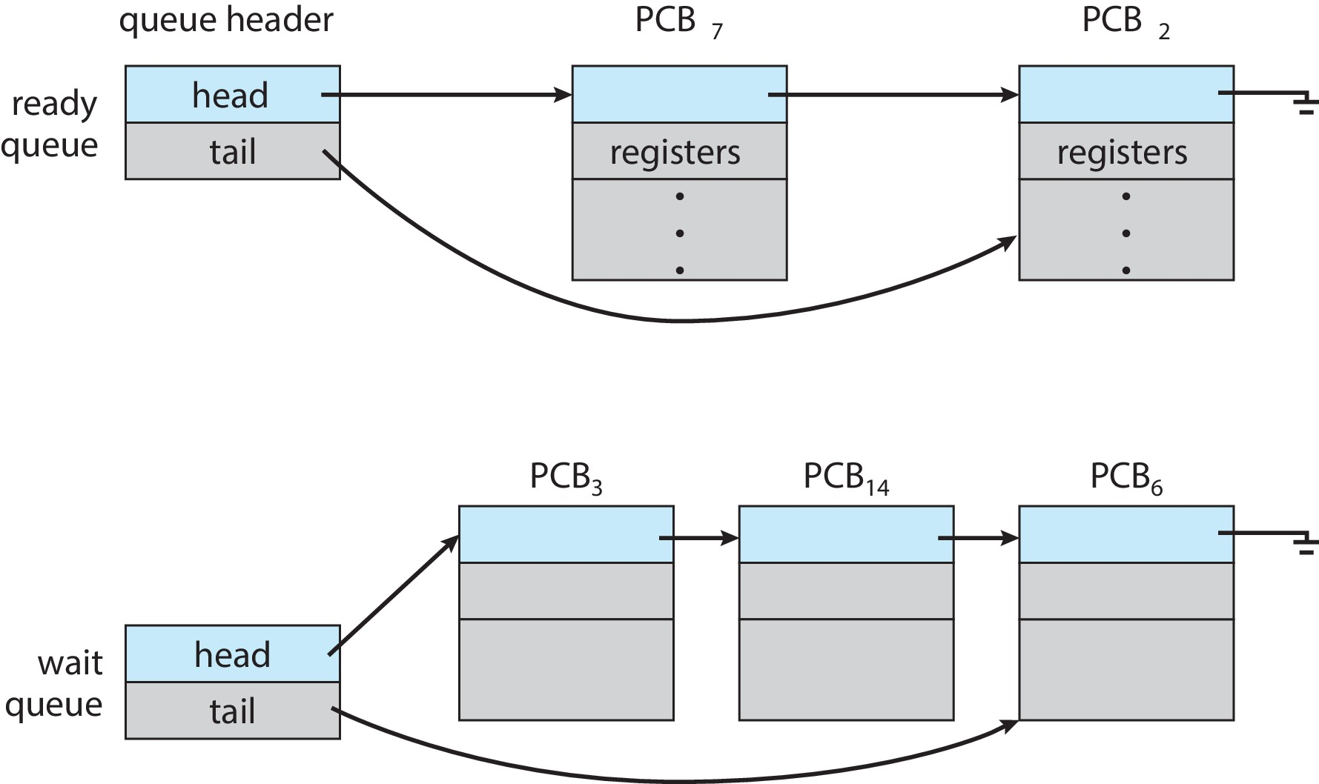
Ready Queue and various Wait Queue
The OS maintains a ready queue containing the PCBs of processes that are ready to execute, and waiting to be dispatched to (selected for execution on) a CPU.
Notes:
Ready queue stored as linked list
Wait queues: i/o wait, child termination wait, interrupt wait

Slide 14
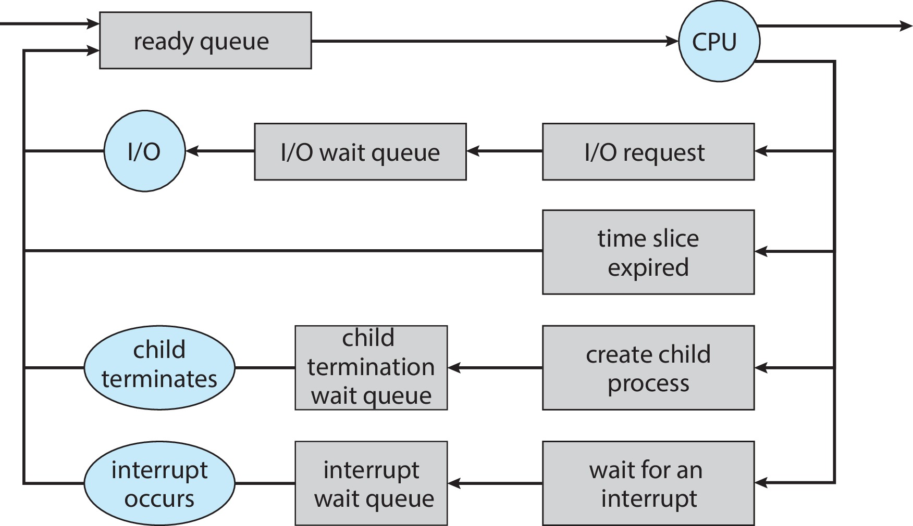
Process Scheduling Queues
Notes:
In these cases, process switches to wait type and then get back to ready queue.
Process will continue this cycle until it removed from all queues. And its PCB and all resources are deallocated

Slide 15
Schedulers (Cont.)
Short-term scheduler is invoked very frequently (milliseconds) ⇒ (must be fast)
Long-term scheduler is invoked very infrequently (seconds, minutes) ⇒ (may be slow)
The long-term scheduler controls the degree of multiprogramming
Processes can be described as either:
I/O-bound process – spends more time doing I/O than computations, many short CPU bursts
CPU-bound process – spends more time doing computations; few very long CPU bursts
WHAT IS SWAPPING ?
Notes:
Cpu allocated on the basis of I/O or cpu bound behavior of a process
CPU burst: the amount of time the process uses the processor before it is no longer ready

Slide 16
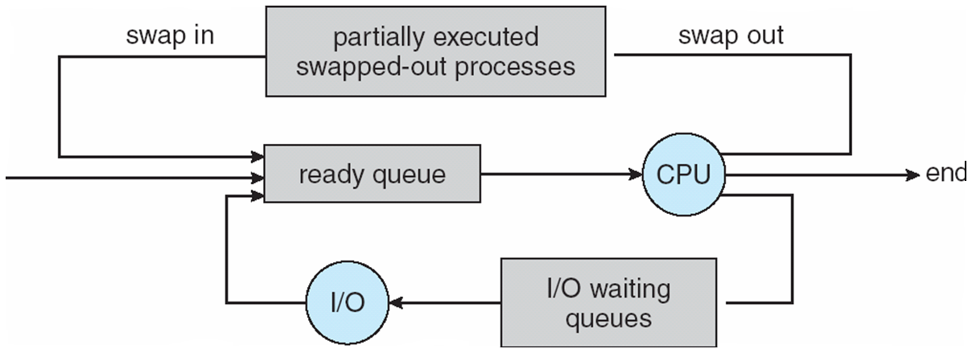
Addition of Medium Term Scheduling
Medium-term scheduler can be added if degree of multiple programming needs to decrease
Remove process from memory, store on disk, bring back in from disk to continue execution: swapping

Slide 17
Context Switch
When CPU switches to another process, the system must save the state of the old process and load the saved state for the new process via a context switch.
Context of a process represented in the PCB
PCB includes What?
Context-switch time is overhead; the system does no useful work while switching
“Saving state of “___” and restoring state .
Notes:
PCB includes the value of the CPU registers, the process state and memory management information.
Saving state of current state of cpu core and restoring state of different process.

Slide 18
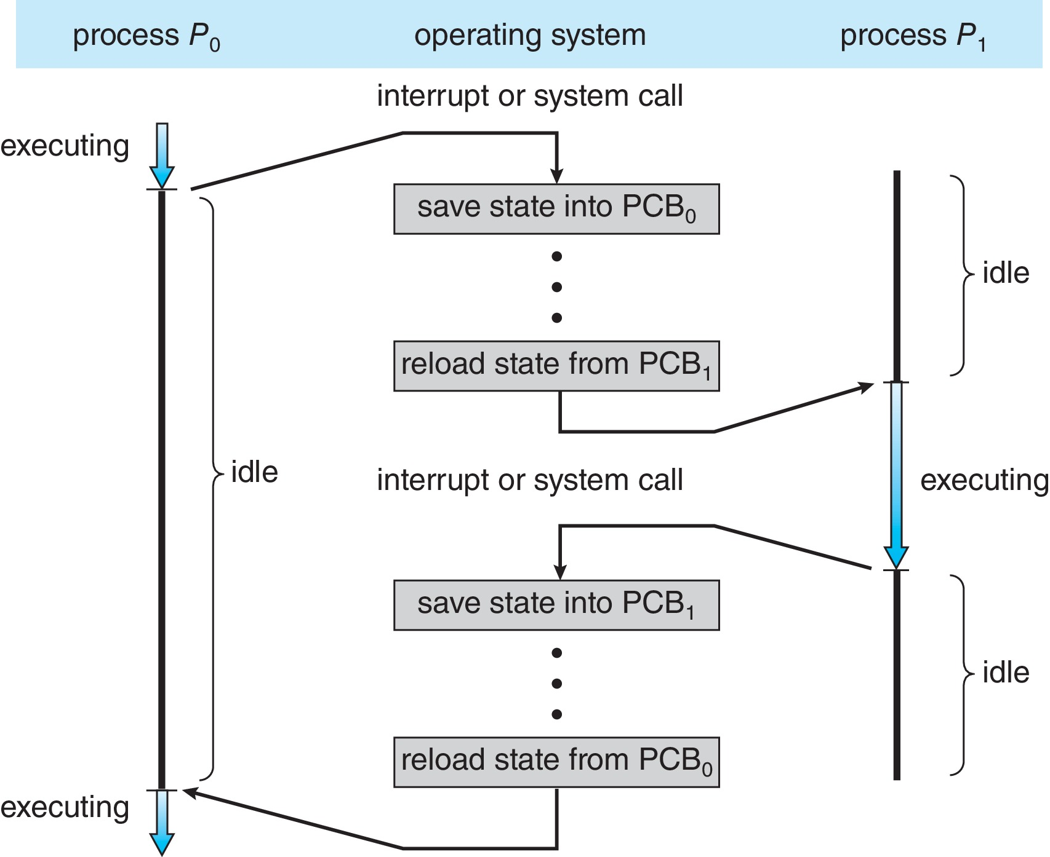
CPU Switch From Process to Process (Context Switching)
Notes:
Q: why context switching times are highly dependent on hardware support?
Q: what factors can speed up the switching ?
Ans: Switching speed varies from machine to machine , depending on the memory speed,
the number of registers that must be copied
and special existence of special instructions.

Slide 19
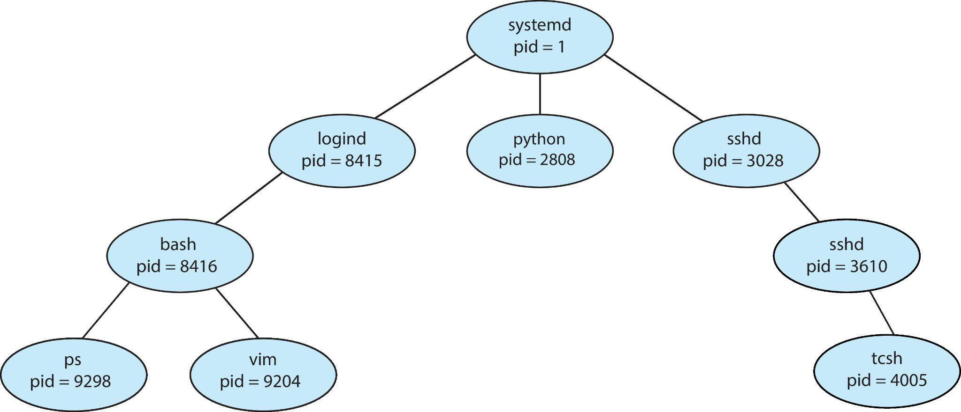
Operation on Processes
Most operating systems build a few processes at boot time.
After that, existing parent processes create new child processes by making a system call.
Child processes can use the system call to make their own children.
Thus there are often extensive "family trees" of processes in modern computing systems

Slide 20
Process Creation
Parent process create children processes, which, in turn create other processes, forming a tree of processes
Generally, process identified and managed via a process identifier (pid)
Resource sharing Options
Parent and children share all resources
Children share subset of parent’s resource
Parent and child share no resources
Execution Options
Parent and children execute concurrently
Parent waits until children terminate

Slide 21
Process Creation (Cont.)
Address space
Child duplicate of parent
Child has a program loaded into it
UNIX examples
fork system call creates new process
exec system call used after a fork to replace the process’ memory space with a new program
Notes:
Q:What will happen if a child process is restricted to a subset of parent ‘s resources? good or bad?
Q:Types of resource?
A:Physical or logical.

Slide 22
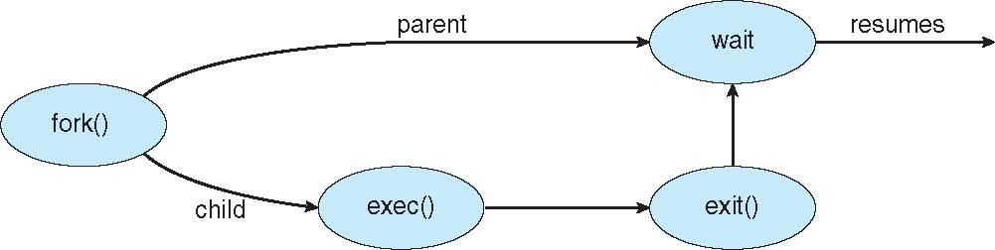
Process Creation

Slide 23
C Program Forking Separate Process
#include <sys/types.h>
#include <studio.h>
#include <unistd.h>
int main()
{
pid_t pid;
/* fork another process */
pid = fork();
if (pid < 0) { /* error occurred */
fprintf(stderr, "Fork Failed");
return 1;
}
else if (pid == 0) { /* child process */
execlp("/bin/ls", "ls", NULL);
}
else { /* parent process */
/* parent will wait for the child */
wait (NULL);
printf ("Child Complete");
}
return 0;
}

Slide 24
Process Termination
Process executes last statement and asks the operating system to delete it (exit)
Output data from child to parent (via wait)
Process’ resources are deallocated by operating system
Parent may terminate execution of children processes (abort)
Child has exceeded allocated resources
Task assigned to child is no longer required
If parent is exiting
Some operating system do not allow child to continue if its parent terminates
All children terminated - cascading termination
Notes:
Pid_t pid;
Int status;
Pid=wait(&status);
Init process becomes parent for orphan child, and wait for it to complete its task.

Slide 25
Interprocess Communication
Processes within a system may be independent or cooperating
An independent process is not affected by the execution of other processes, while a cooperating process can be affected by other executing processes.
Programmers want to write programs that implement cooperating process, BUT Why?
Information sharing (copy,paste)
Computation Speed:On a multiprocessor, multiple processes can get more work done on an application in less time.
Modularity(separate system functions)
Cooperating processes need interprocess communication (IPC)
Two models of IPC
Shared memory (use a share space to communicate)
Message passing (use system calls to communicate)
Notes:
What is the difference in process being independent or cooperating?

Slide 26
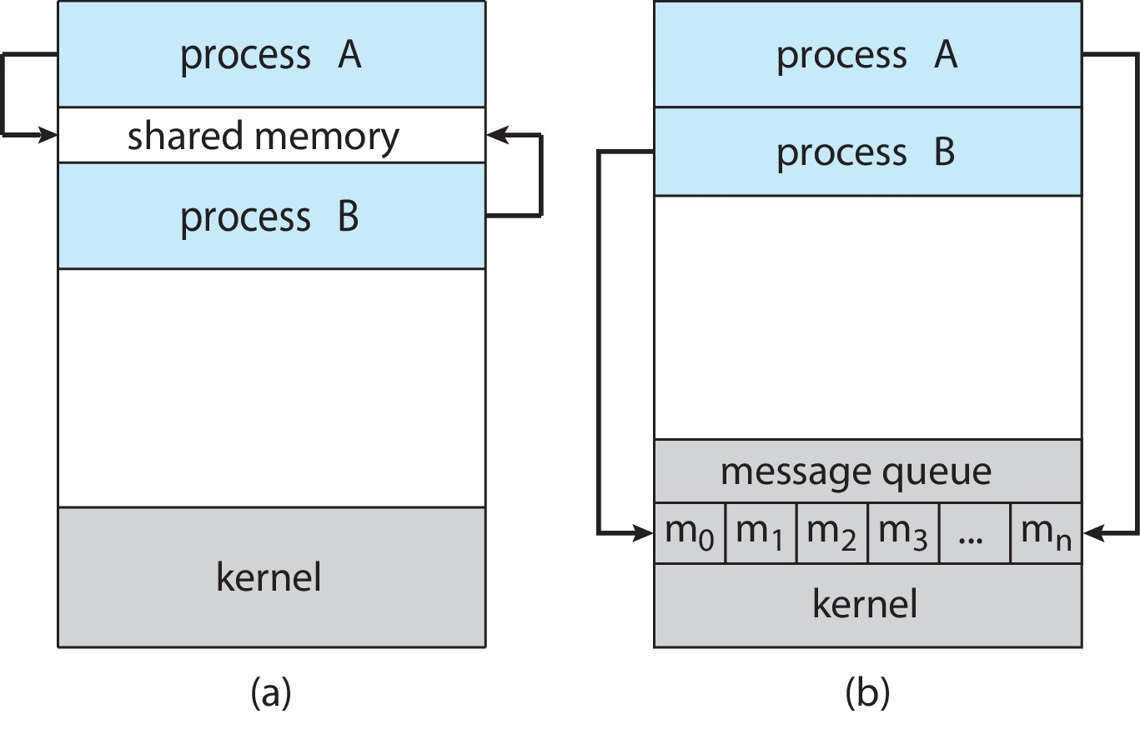
Communications Models
Notes:
Smaller amount of data
Shared memory is faster, b/c no kernel intervention except in creating shared memory region

Slide 27
Shared memory Method
The two processes shares a common space or memory location known as the “buffer,” where the item produced by the Producer is stored and from where the Consumer consumes the item if needed.
Shared memory region with buffer:
unbounded-buffer places no practical limit on the size of the buffer
bounded-buffer assumes that there is a fixed buffer size
Notes:
Producer(produce) -> consumer
Compiler (assembly code) - assembler
Assembler(object)-> loader

Slide 28
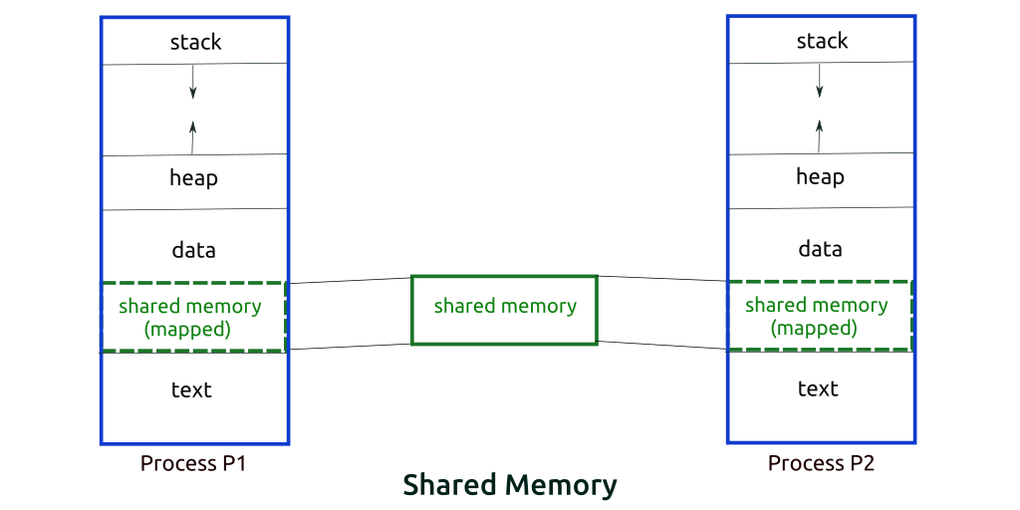
Bounded Shared Memory

Slide 29
IPC in shared Memory: Producer-Consumer Problem
In the bounded buffer problem,
the Producer and the Consumer will share some common memory.
Then the Producer will start producing items. If the total number of produced items is equal to the size of buffer,
the Producer will wait until they’re consumed by the Consumer.
Similarly,
the Consumer first checks for the availability of the item,
and if no item is available, the Consumer will wait for the Producer to produce it.
If there are items available, the Consumer will consume them.
Home Task: write algorithm for consumer producer given above conditions.

Slide 30
Interprocess Communication – Message Passing
Mechanism for processes to communicate and to synchronize their actions
Without same address space
IPC facility provides two operations/primitive:
send(message) – message size fixed or variable
receive(message)
If P and Q wish to communicate, they need to:
establish a communication link between them
exchange messages via send/receive
Implementation of communication link
physical (e.g., shared memory, hardware bus)
logical (e.g., logical properties)
Notes:
Used in distributed environment
Does not require a shared address space

Slide 31
Implementation Questions
How are links established?
Can a link be associated with more than two processes?
How many links can there be between every pair of communicating processes?
What is the capacity of a link?
Is the size of a message that the link can accommodate fixed or variable?
Is a link unidirectional or bi-directional?
Notes:
Direct or indirect communication
Synchronous or asynchronous
Automatic or explicit buffering

Slide 32
Message Passing:
Must establish communication link:
Three key issues to be resolved in MP:
Naming (direct/ indirect communication)
Synchronization ( blocking / non blocking sending or receiving msg)
Buffering (message queue capacities)
Naming:
Direct communication: must explicitly name the recipient or sender), link exist between just two processes.
if both are naming each other: symmetric addressing
if only sender names the recipient and receiver is not required to name sender: asymmetric addressing
Indirect Communication: message sent and received through mail boxes or port (a unique ID)
Notes:
Direct:
Send(p,mesg) send message to p
Recv(q , message) recv mesg from q,
Indirect:
Send(p,mesg) send message to p
Recv(id , message) recv mesg from any process, id is set to the name of process with communication took place

Slide 33
Message Passing: indirect
Mailbox sharing
P₁, P₂, and P₃ share mailbox A
P₁, sends; P₂ and P₃ receive
Who gets the message?
Solutions
Allow a link to be associated with at most two processes
Allow only one process at a time to execute a receive operation
Allow the system to select arbitrarily the receiver. Sender is notified who the receiver was.
Mailbox :
Either user create it and control its mangament operation
Or system creates it.

Slide 34
Message Passing:
b) Synchronization:
Blocking is considered synchronous
Blocking send has the sender block until the message is received
Blocking receive has the receiver block until a message is available
Non-blocking is considered asynchronous
Non-blocking sender: sends the message and continue
Non-blocking receiver: retrieves either a valid message or a null
Any example of non blocking sender /receiver ?

Slide 35
Message Passing
c) Buffering
Queue of messages attached to the link; implemented in one of three ways
Zero capacity – 0 messages waiting in a queue.
Which type of sender?
Bounded capacity – finite length of n messages, n messages waiting in a queue
Will sender block here?
Unbounded capacity – infinite length ,any number of messages can wait in a queue

Slide 36
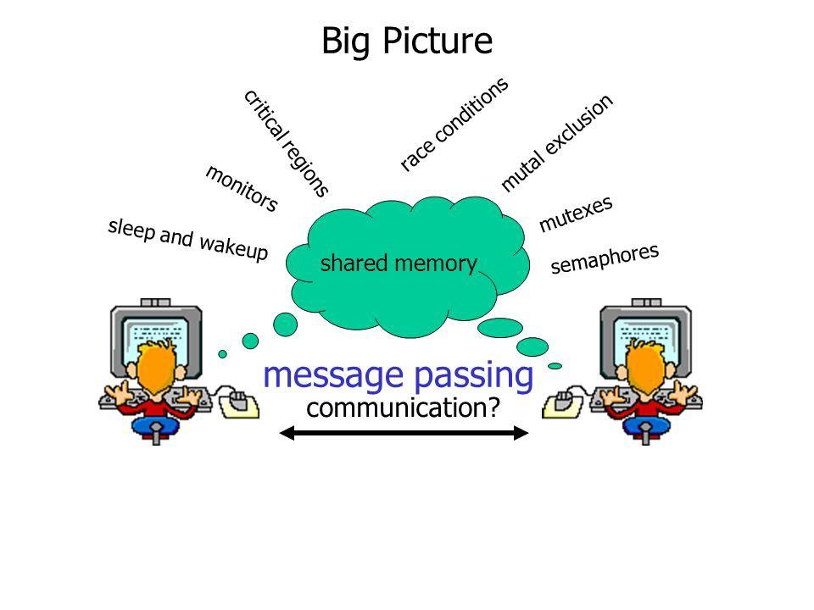
Identify the problems:

Slide 37
Examples of IPC Systems:
Home Task.
Implement the following code given in book and share the output.
POSIX: consumer -producer
POSIX: ordinary pipes in linux

Slide 38
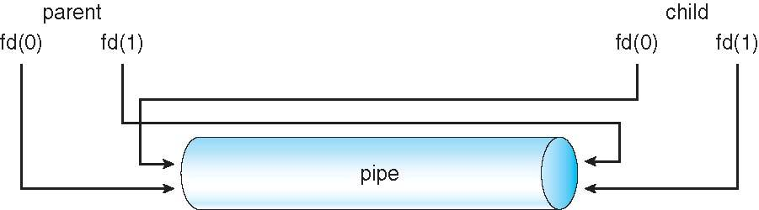
Ordinary Pipes
Notes:
Write a code for bi directional communication between parent and child process.

Slide 39
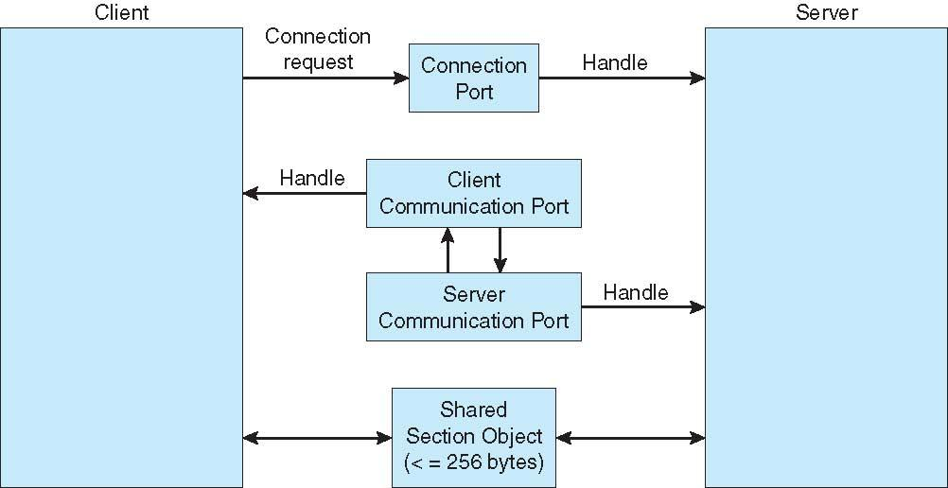
Examples of IPC Systems – Windows
Message-passing centric via Advanced local procedure call facility
.three mp techniques through API channel
small message (up to 256kb)
large message: passed through section object(Shared memory region)
too large amount of data: system call for direct read

Slide 40
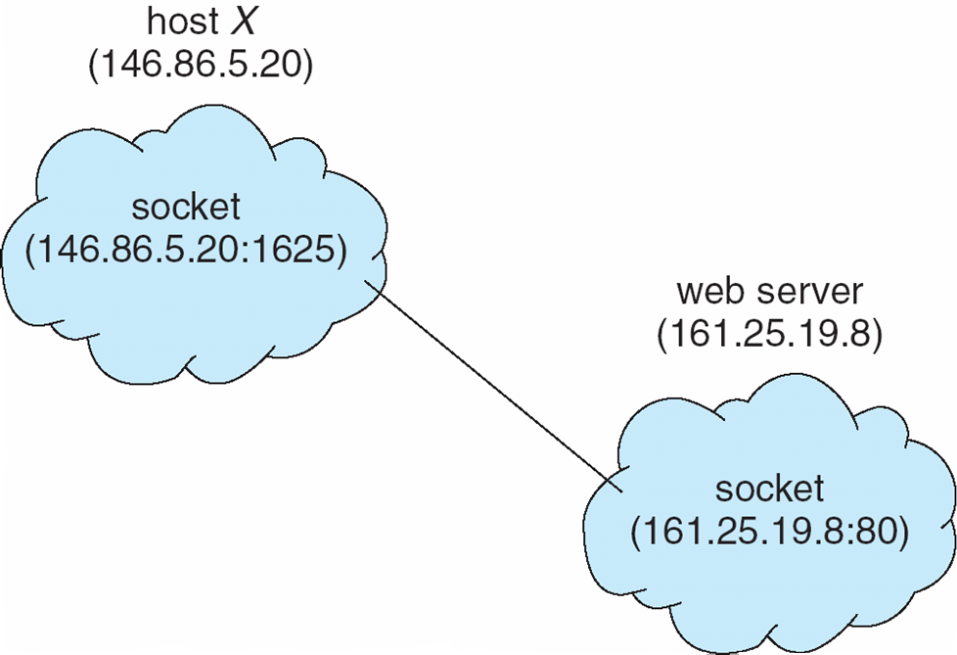
Communications in Client-Server Systems
Sockets:
A socket is defined as an endpoint for communication
Concatenation of IP address and port
The socket 161.25.19.8:1625 refers to port 1625 on host 161.25.19.8
Communication consists between a pair of sockets

Slide 41
Communications in Client-Server Systems
Remote Procedure Calls:
Remote procedure call (RPC) abstracts procedure calls between processes on networked systems
Stubs – client-side proxy for the actual procedure on the server: it hides the details that allow communication to take place.
The client-side stub locates the server and marshalls the parameters:
Stub: written in Microsoft Interface Definition Language (MIDL)-defining interface between client and server prog

Slide 42
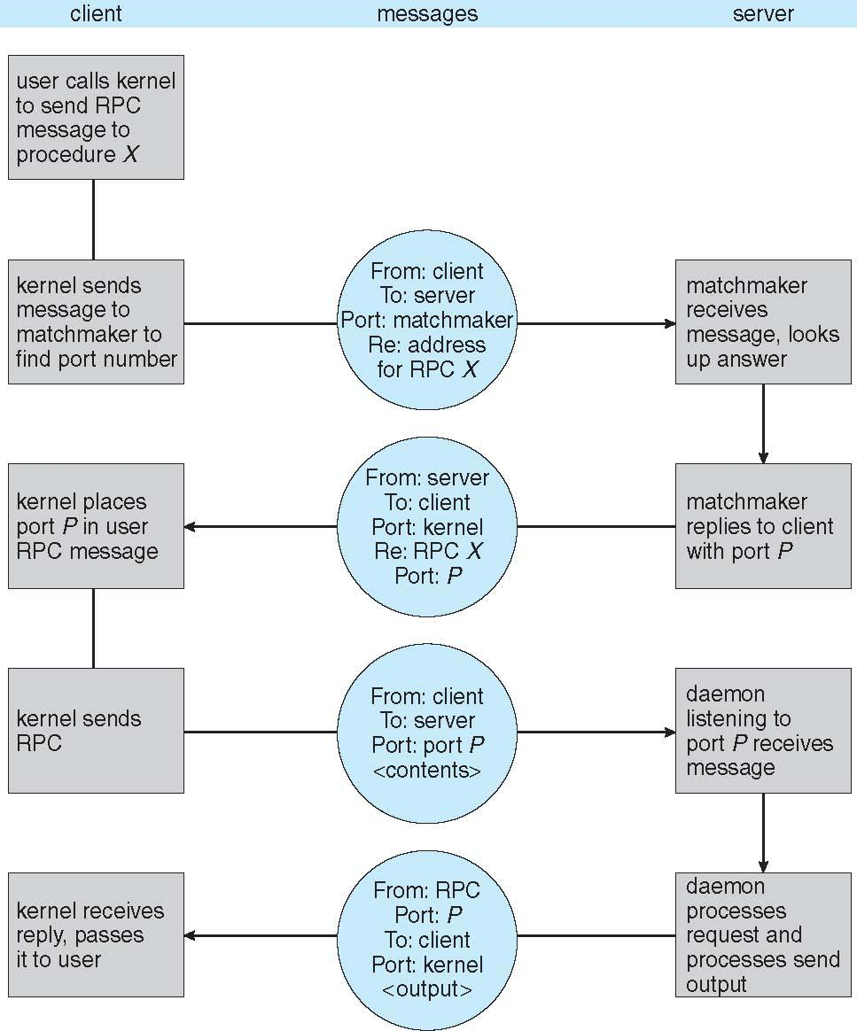
Execution of RPC

